Slide 1
Optimising Models of Care for Molecular Radiotherapy services at [Insert Name]
Service Evaluation Meeting
Job code: AAA-Lu177-UK-1214
Date of preparation: September 2021

Slide 2
Welcome and introductions

Slide 3
Overarching project plan
Service evaluation meeting
Implementation planning meeting
Understand what the current molecular radiotherapy service looks like
1
Evaluate the current provision and identify opportunities to optimise the service model
2
Consider alternative models of care and select the approach to take forward
3
Develop an implementation plan with key actions and responsibilities
4

Slide 4
Meeting objectives
Understand what the molecular radiotherapy service looks like
1
Evaluate the current provision and identify opportunities to optimise the service model
2

Slide 5
Meeting agenda
Time | Agenda Item | Lead
9.00 | Welcome, introductions and meeting objectives | [Insert name]
9.15 | [Insert name] vision for service change Presentation (15 minutes) | [Insert name]
9.30 | Understanding the [Insert name] patient population and demographics Presentation and facilitated discussion (30 minutes) | [Insert name]
10.00 | Seeing the patient perspective Presentation and facilitated discussion (30 minutes) | [Insert name]
10.30 | [Insert name] service resource use Presentation and facilitated discussion (60 minutes) | [Insert name]
11.30 | Coffee break
11.45 | Opportunities to optimise the service and alternative model approaches Brainstorming exercises and facilitated discussion (60 minutes) | [Insert name]
12.45 | Action planning Facilitated discussion and action planning (45 minutes) | [Insert name]
13.30 | Meeting summary and close

Slide 6
Meeting housekeeping
Please place phones on silent and avoid using laptops. There will be time during the mid-morning break to respond to important messages
We welcome your full participation, and honest, direct opinions and advice
Please help us to keep to meeting timings. We may need to park some issues to discuss later
Please ensure you know the location of the nearest fire exit

Slide 7
[Insert name] vision for service change

Slide 8
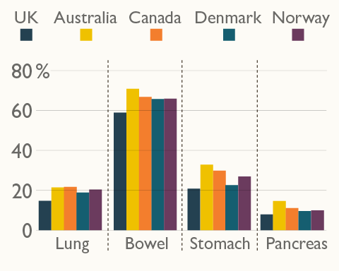
Cancer outcomes in the UK are poor compared to other countries
Five-year cancer survival, 2010–2014
While five-year cancer survival rates have improved over time, outcomes in the UK are poor compared with other high-income countries¹
Between 2010–2014, 5 year survival for stomach cancer reached 20.8% in the UK compared with 32.8% in Australia and 29.8% in Canada¹
Source: Lancet Oncology¹
UK, United Kingdom
1. Arnold M et al. Lancet Oncol 2019; 11: 1492-1505

Slide 9
The NHS Long Term Plan includes specific ambitions for cancer
The key ambitions of the NHS Long Term Plan are that by 2028:¹
55,000 more people each year will survive their cancer for five years or more
75% of people with cancer will be diagnosed at an early stage (stage one or two)
How will this be achieved?¹
Increased bowel screening, cervical cancer screenings and lung health checks
Creation of Rapid Diagnostic Centres
Introduce a new, faster diagnosis standard to diagnose patients within 28 days
Give patients more say over the care they receive with personalised care packages
Safer and more precise treatments including advanced radiotherapy techniques and immunotherapies
NHS, National Health Service
1. NHS. NHS Long Term Plan. 2019. Available at: https://www.longtermplan.nhs.uk/ (accessed May 2020).

Slide 10
Optimising patient-centred services across the NHS is a key component of NHS policy
By 2021, every patient with cancer will have access to personalised care, including needs assessment, a care plan and health and wellbeing information and support¹
How will this be achieved?¹
Boosting out of hospital care by:
Creating fully integrated teams of GPs, community health and social care staff
Supporting people in their own homes as an alternative to hospitalisation
Promoting self-care and self-management through:
‘Social prescribing’
Personal health budgets
Support from patient groups and the voluntary sector
Upgrading technology and digitally enabled care by:
Connecting home-based and wearable technology
Providing access to digital GP consultations
GP, general practitioner; NHS, National Health Service
1. NHS. NHS Long Term Plan. 2019. Available at: https://www.longtermplan.nhs.uk/ (accessed May 2020).

Slide 11
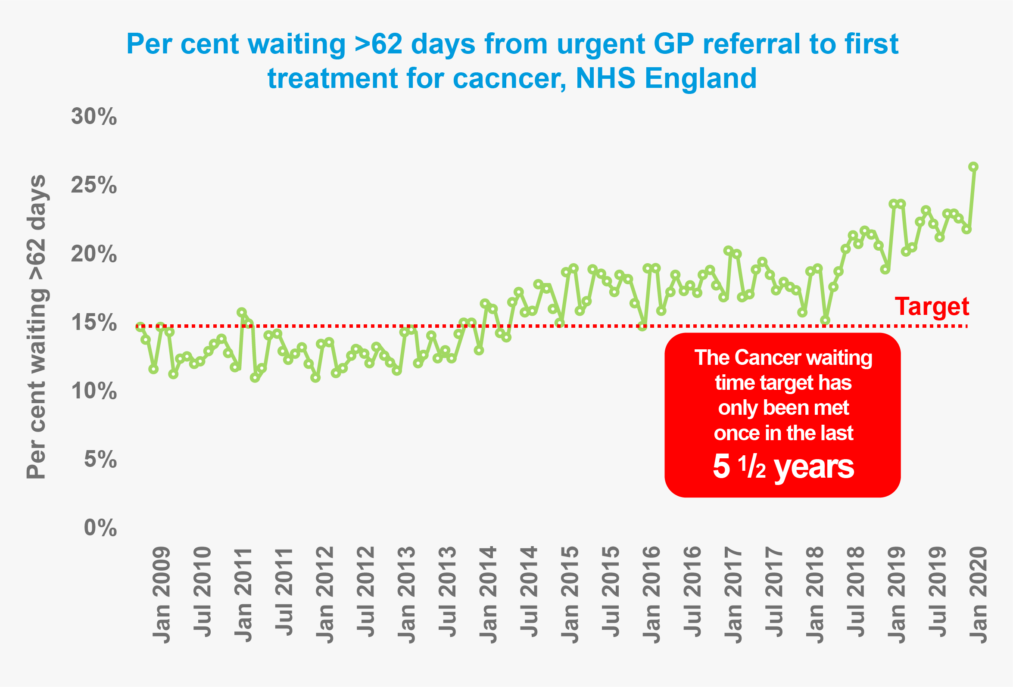
The NHS must embrace change to overcome the challenges of increasing pressure on services and growing demand
Demand for NHS services is continuing to rise due to:¹
The proportion of cancer patients waiting longer than 62 days for treatment following urgent GP referral is increasing over time and reached a peak of 26% in January 2020³
A growing, aging population
Longstanding unmet health needs
Advances in medical science
To accommodate this the NHS needs to:²
Integrate health and social care
Upgrade prevention
Increase investment in community services to avoid hospital use and provide care in people’s homes
Enable hospital specialists to work across hospitals and the community to support the redesign of services needed in the future
GP, general practitioner; NHS, National Health Service
1. NHS. NHS Long Term Plan. 2019. Available at: https://www.longtermplan.nhs.uk (accessed May 2020). 2. Kingsfund. 2016. Available at: https://www.kingsfund.org.uk/publications/hospital-activity-funding-changes#conclusion (accessed April 2020) 3. Nuffield Trust. 2020. Available at: https://www.nuffieldtrust.org.uk/news-item/combined-performance-summary-january-february-2020 (accessed April 2020)
Source: Nuffield Trust³

Slide 12
The expansion of molecular radiotherapy services can support the NHS in meeting key cancer policy objectives
Improvement in cancer survival and mortality is needed¹
Personalised care and patient choice is
important¹
Patients need improved access to precise treatments and to specialist expertise and knowledge¹
Patient care should be provided closer to home¹
Expanding molecular radiotherapy services allows patients better access to effective treatments leading to improved cancer outcomes. Patients are also given the choice to have treatment closer to home.
This has the potential to help the NHS meet the key cancer objectives set out in the Long Term Plan.¹
NHS, National Health Service
1. NHS. NHS Long Term Plan. 2019. Available at: https://www.longtermplan.nhs.uk (accessed May 2020).

Slide 13
Efficient implementation of new models of care can help address longer waiting times or reduced service quality
Create capacity in the service
1
Allow more efficient NHS resource use
2
Improve overall patient experience
3

Slide 14
Key challenges the [insert name] molecular radiotherapy service currently faces
[List the key challenges faced by the molecular radiotherapy service. Suggestions include
Capacity and demand
Staffing and workload
Waiting times
Sustainability
Patient experience
Staff experience
Consider how this is anticipated to change over the short, medium and long-term]

Slide 15
Current service evaluation
Presentation and facilitated discussion

Slide 16
The current [insert name] molecular radiotherapy service
[The template agenda suggests 1.5 hours to explore in detail the local service provision. Feel free to break this up in the way that is most relevant to your service evaluation need.
You might want to use this time to discuss data about:
Your service user population and their demographics
The patient journey and patient satisfaction metrics
Capacity, demand and sustainability metrics for the current service model
Create slides here that allow the meeting attendees to effectively evaluate the current service]

Slide 17
Coffee break

Slide 18
Opportunities to optimise the service and alternative service models
Brainstorming exercise and facilitated discussion

Slide 19
What are the key opportunities for service improvement?
Exercise – Which aspects of our service are we looking to improve?
Objective: Identify the key areas where the service can be optimised to [insert local need for change. For example: create capacity, reduce waiting times and improve overall patient experience]
[Some possible areas for consideration are provided here. Consider whether these match identified gaps in the current service pathway or replace with others that better reflect local need for change]
Access to the service
Clinic wait
In-chair time
Treatment setting
Molecular radiotherapy preparation
Waste reduction
Toxicity management
Capacity
Opening times
Patient transport

Slide 20
Molecular radiotherapy services can be optimised to improve capacity
Exercise – What new model(s) of care could be implemented to resolve current challenges with the radiopharmaceutical service?
Objective: Identify different ways that the current service could be delivered more efficiently or effectively
[Examples of new service designs are provided here. Consider whether these match identified gaps in the current service pathway or replace with others that better reflect local need for change]

Slide 21
Action planning

Slide 22
Action planning – implementation and responsibilities
As an output of the meeting, agree:
What?
What are the key steps and actions that need to be taken? Be specific and list these in detail
Who?
Assign responsibility for each task
How?
Ensure that there is a clear plan to action each task
When?
Assign a completion date for each task, and interim review meetings if necessary

Slide 23
Summary and close

